Slide 1


BioMath Health Assistant
Bridging Mathematics and Biology for Smarter Healthcare
BioMaths_Health_Assistant| August 2025

Slide 2

Content
Outline
01
Overview of the Project
02
Purpose & Goals
03
Platform Availability
BioMaths_Health_Assistant| August 2025
Topics for discussion
04
Target Users

Slide 3
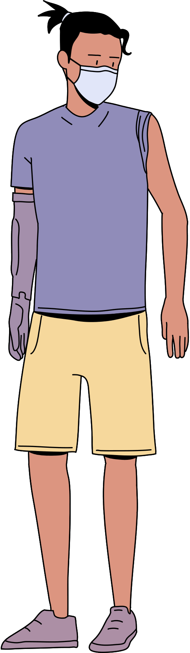
Problem Statement
Manual Processes – Health calculations and records are often done by hand, leading to errors.
Fragmented Tools – Patient data, appointments, and inventory are stored in different systems.
Lack of Risk Analysis – No built-in system to classify patient health risks early.
Time & Resource Waste – Staff spend more time on paperwork than on patient care.
BioMaths_Health_Assistant| August 2025

Slide 4


The BioMath Health Assistant automates health calculations, provides instant risk classification, centralizes patient management, and promotes maths–biology integration for education and healthcare efficiency.
BioMaths_Health_Assistant| August 2025

Slide 5
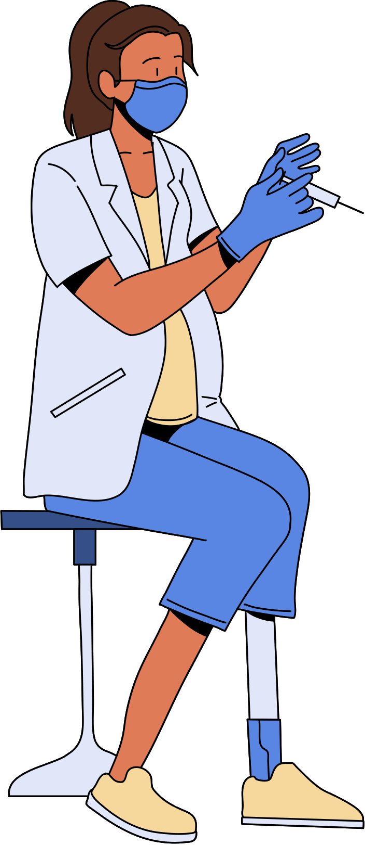

PROJECT OVERVIEW
Dual-platform health management system
in 2025
he BioMath Health Assistant operates as both a formula-driven Google Sheets tool and a cloud-enabled web application, delivering automated health calculations, patient management, and data visualization for diverse healthcare and educational applications.
BioMaths_Health_Assistant| August 2025

Slide 6

Data Edition
Patient Records: Maintain detailed patient profiles with medical history and contact information.
Appointments: Schedule, track, and manage patient visits with date and time slots.
Medicine Inventory: Monitor stock quantities, expiry dates, and re-order alerts.
Billing: Automate invoice creation, cost calculations, and payment tracking.
Health Calculators: Built-in BMI, BMR, and dosage formulas for instant results.
Charts & Reports: Generate visual graphs for patient progress and resource usage.
BioMaths_Health_Assistant| August 2025

Slide 7

User Interface
Modern Design: Clean, visually appealing layout.
Responsive Layout: Works on desktop, tablet, and mobile.
Easy Navigation: Simple menus for quick access to features.
Web App Edition
Health Tools
BMI & BMR Calculators: Instant results with user input.
Dosage Calculator: Personalized medicine dosage calculation.
Vital Signs Tracking: Monitor BP, heart rate, temperature.
BioMaths_Health_Assistant| August 2025
Data & Reports
Risk Analysis: Classify patients as low, medium, or high risk.
Interactive Charts: View trends over time.
Cloud Storage: Access data securely from anywhere

Slide 8

Automated Health Calculations
Risk Assessment & Visualization
- BMI & BMR
- Dosage & Trends
- Risk Classification
- Interactive Charts
Instantly computes body metrics and medicine dosage while tracking patterns over time for better patient monitoring.
Categorizes patients into risk levels and displays health data in real-time charts for quick and clear analysis.
BioMaths_Health_Assistant| August 2025

Slide 9








Data Visualization
Live Charts:
The BioMath Health Assistant features live, auto-updating charts that instantly display changes in patient health metrics. These visual tools allow healthcare professionals to quickly interpret data such as vital signs, BMI, and other key indicators. By seeing progress in a visual format, decision-making becomes faster and more accurate, reducing the need to go through lengthy tables of numbers.
Interactive Analysis:
The system’s interactive analysis tools allow users to filter data by patient name, date range, or specific health parameter. This makes it possible to focus on individual cases or compare multiple patients’ health trends side by side. With visual trends and patterns clearly shown, healthcare providers can identify risks earlier, track treatment effectiveness, and ensure better patient care.

Slide 10

Risk Assessment
Early Detection:
Identifies abnormal trends early, allowing timely medical intervention before conditions worsen.
Health Risk Classification:
Preventive Care Support:
Automatically categorizes patients into low, medium, or high risk based on BMI, vitals, and other metrics for quick prioritization.
Helps in monitoring at-risk patients regularly to reduce complications and improve long-term health outcomes.
Google Sheets & Web App | August 2025

Slide 11
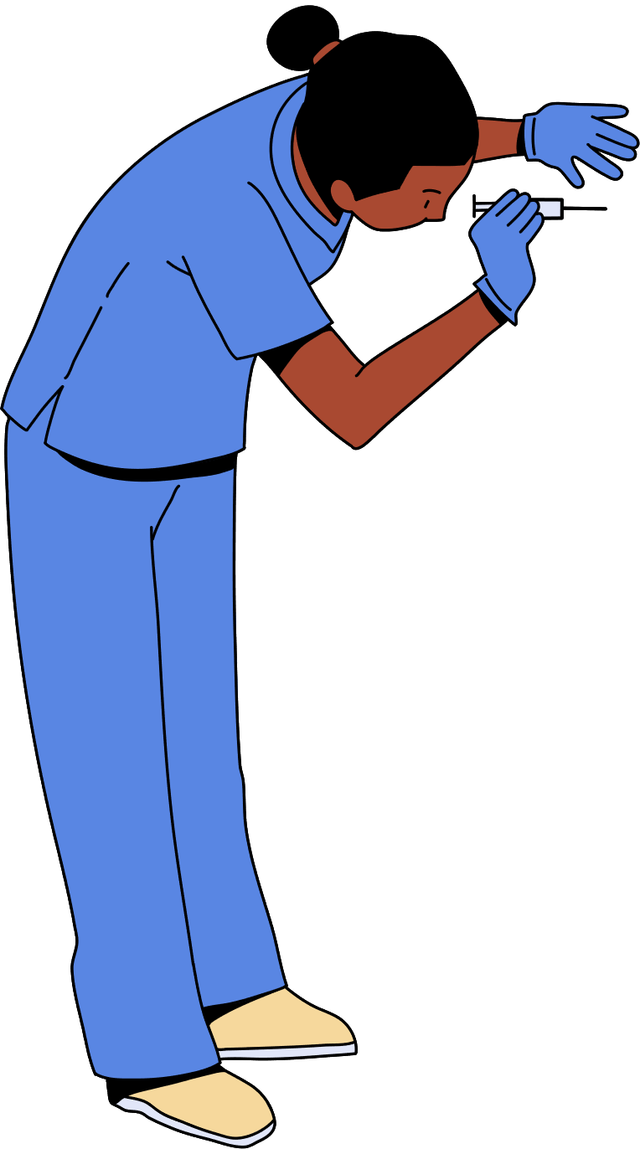
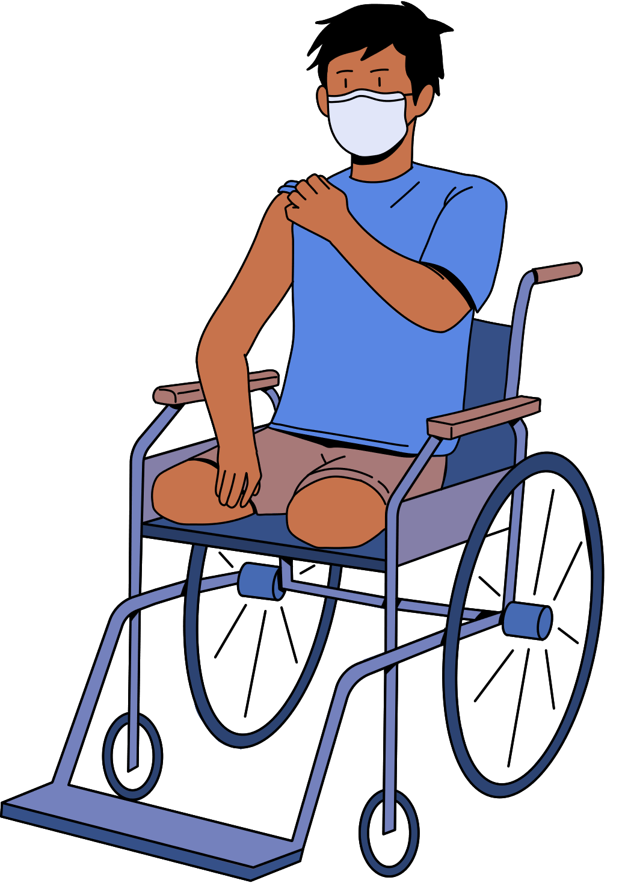
Goals of Innovation
Improve Efficiency
Enhance Accuracy
Automate calculations, scheduling, and record keeping to save time and streamline workflows
Use formulas and algorithms to reduce errors in health data and metric computation.
Promote Data
Support Healthcare
Provide real-time insights and trends for faster, evidence-based decisions.
Detect risks early to enable timely intervention and reduce future complications.
BioMaths_Health_Assistant| August 2025

Slide 12
Proposed Timeline
An ongoing journey
Phase 1
Phase 3
Research & Planning (Week 1-2): Define objectives, gather requirements, and design system workflow.
Integration (Week 7): Connect health calculators, risk analysis, and data visualization modules.
Phase 5
Launch platforms and train users for smooth adoption.
BioMaths_Health_Assistant| August 2025
Phase 2
Phase 4
Development (Week 3-6): Create Google Sheets and Web App versions with core features.
Testing & Debugging (Week 8): Check accuracy, fix errors, and optimize performance.

Slide 13


Thank you
for your time and attention.
BioMaths_Health_Assistant| August 2025

